Slide 1

WEEK-8 PREPOSITION OF TIME AND PLACE
Rahmanti Asmarani, M Hum.

Slide 2
A preposition is a word used to link nouns, pronouns, or phrases to other words within a sentence.
A preposition is usually a short word placed before a substantive (or a pronoun)
indicating the relation of that substantive to other parts of the sentence (mostly verbs).
nice way to think about prepositions is as the words that help glue a sentence together.
They do this by expressing position and movement, possession, time and how an action is completed.

Slide 3
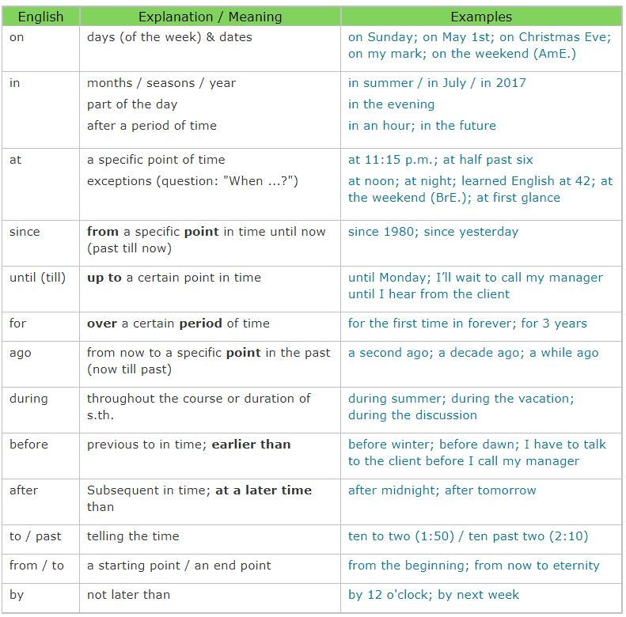
Preposition of time (temporal), basic examples of time prepositions include: at, on, in, before and after. They are used to help indicate when something happened, happens or will happen. It can get a little confusing though, as many different prepositions can be used.

Slide 4
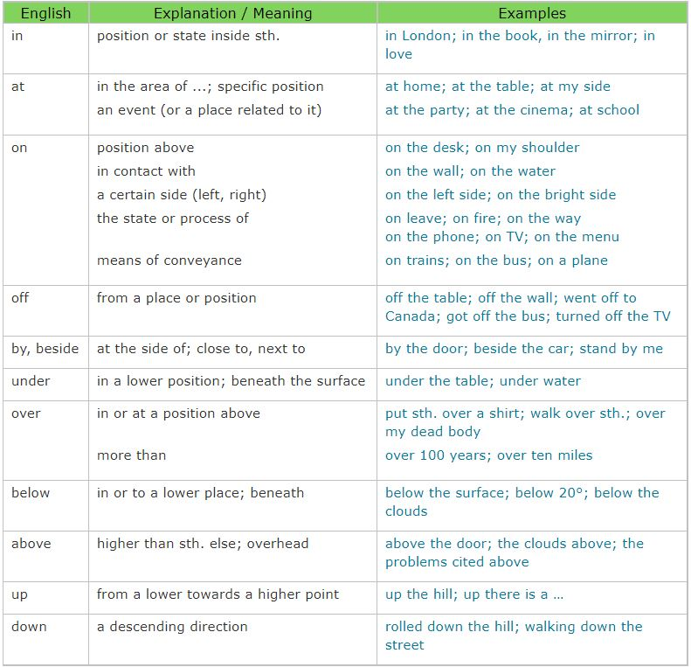
Preposition of place (spatial), To confuse matters a bit, the most common prepositions to indicate time – on, at, in – are also the most common prepositions to indicate position. However, the rules are a little clearer as place prepositions are a more rigid concept than time prepositions.

Slide 5
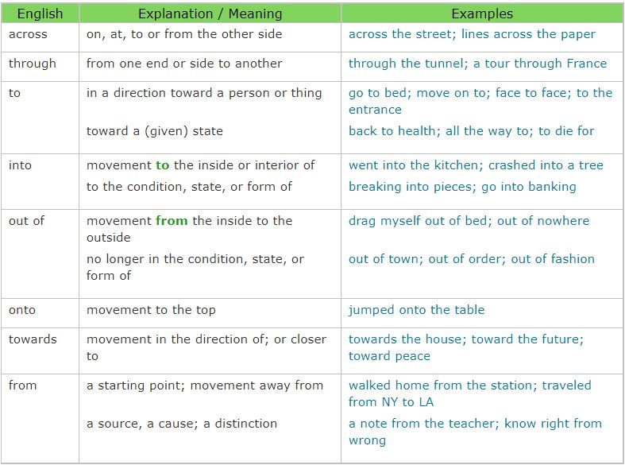
Preposition for direction (or movement), Prepositions of movement are quite easy to understand as they are less abstract than prepositions of place and time. Essentially, they describe how something or someone moves from one place to another. The most commonly used preposition of movement is to, which usually serves to highlight that there is movement towards a specific destination.

Slide 6
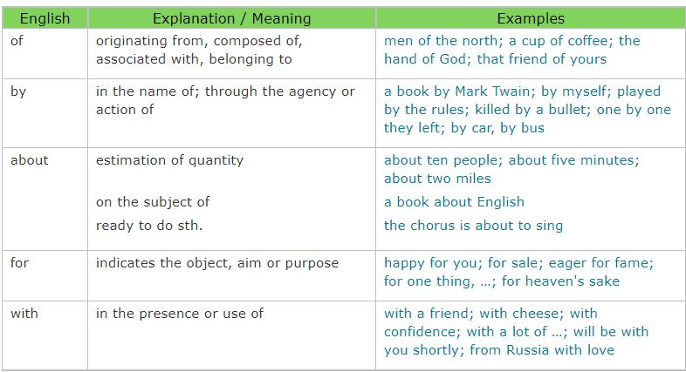
Preposition for device, instrument or machines, A preposition for agent or instrument is used for a thing which is cause of another thing in the sentence. Different prepositions are used by different devices, instruments or machines.

Slide 7
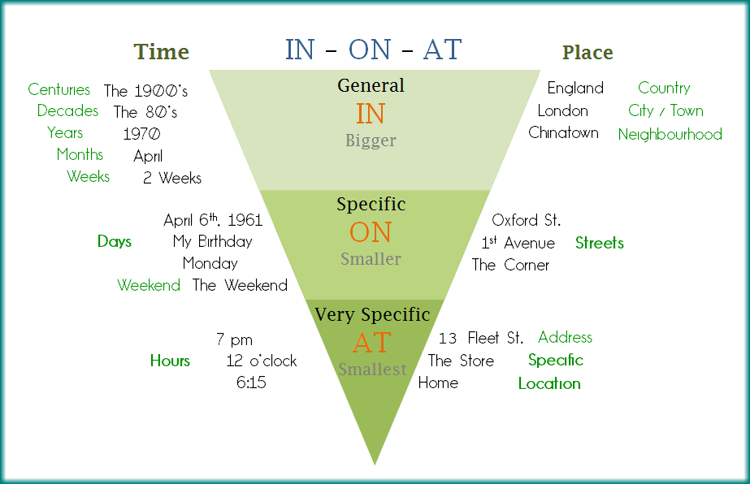

Slide 8
Exercise
Prepositions of time
Put in the correct preposition (at, in, on, or no preposition):
Lucy is arriving ____ February the 13th ____ 8 o'clock ____ the morning.
The weather is often terrible in London _____ January.
It’s better to get a taxi if you are out alone _____ night.
She got married _____ September.
They usually go to the south of France _____ the summer.
Columbus sailed to the Americas _____ the 16th century.
The Beatles were popular _____ the 1960s.
I graduated from university _____ 2001.
His birthday is _____ June.
I usually go to my parents’ house _____ Christmas. We eat turkey together _____ Christmas Day.

Slide 9
Exercise
Prepositions of Place
He’s swimming ______ the river.
Where’s Julie? She’s ______ school.
The plant is ______ the table.
There is a spider ______ the bath.
Please put those apples ______ the bowl.
Frank is ______ holiday for three weeks.
There are two pockets ______ this bag.
I read the story ______ the newspaper.
The cat is sitting ______ the chair.
Lucy was standing ______ the bus stop.

